Slide 1



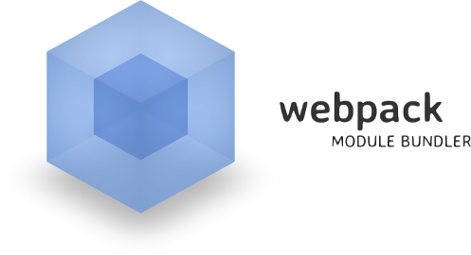
Building Lightweight Websites using TypeScript, NPM and Webpack

